Slide 1

Team name: EdgeTech
Team leader name: Rahil Masood
Problem Statement: Bridging the Education and Digital Literacy Gap for
Marginalized Communities

Slide 2

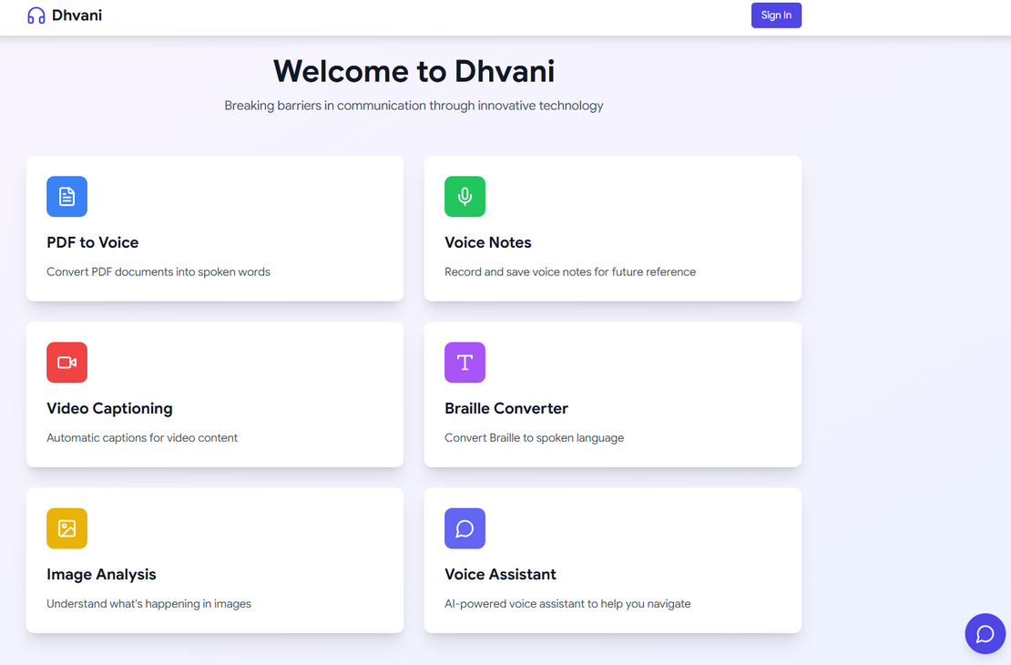
BRIEF ABOUT YOUR SOLUTION:
Dhvani is an innovative web application designed to empower individuals with hearing and speech impairments. By leveraging cutting-edge technology and Google's powerful AI tools, we're making communication more accessible and inclusive for everyone.

Slide 3
HOW DIFFERENT IS DHVANI
FROM OTHER EXISTING IDEAS?
USP
HOW WILL DHVANI
SOLVE THE PROBLEM?
All-in-One Accessibility Tool – Combines PDF-to-voice, video captioning, Braille-to-speech, and AI assistance in one platform.
Offline Support – Works without the internet for key features, unlike most cloud-based assistive apps.
AI-Powered Context Awareness – Uses Google's Gemini AI for more accurate speech, text, and image processing.
Highly Customizable & Cross-Platform – Supports multiple languages, voice adjustments, and works on web, mobile, and desktop.
All-in-One Accessibility Platform – Integrates multiple assistive technologies in a single, AI-powered application.
Offline Accessibility – Works without an internet connection for critical features, unlike most cloud-based services.
Google AI for Context-Aware Assistance – Uses Gemini API, Speech-to-Text, and Vision AI for more accurate and intelligent communication.
Multimodal Support – Supports text, speech, images, and videos, ensuring a richer experience than single-modality apps.
Highly Customizable & Inclusive – User-controlled voice selection, language preferences, and WCAG-compliant UI for broader accessibility.
Bridges Communication Gaps – Converts speech, text, and Braille to assist hearing- and speech-impaired users.
Improves Digital Literacy – Provides AI-powered reading and transcription tools for better access to education.
Enhances Social Inclusion – Enables seamless conversations via real-time video captioning and voice assistants.
Empowers Independence – AI-driven image analysis and voice interactions reduce reliance on human assistance.

Slide 4
LIST OF FEATURES OFFERED BY THE SOLUTION
🔹 Key Features at a Glance
✅ PDF to Voice – Convert PDFs into speech with multi-language support & real-time status
✅ Voice Notes – Record & transcribe with auto-punctuation & offline storage
✅ Video Captioning – Real-time, multi-language captions with editing options
✅ Braille to Speech – Convert Braille text into clear, adjustable voice output
✅ Image Analysis – Scene descriptions, object detection & spatial awareness
✅ AI Voice Assistant – Smart, voice-activated navigation with offline fallback
✅ Accessibility First – WCAG-compliant, offline capabilities & privacy-focused

Slide 5
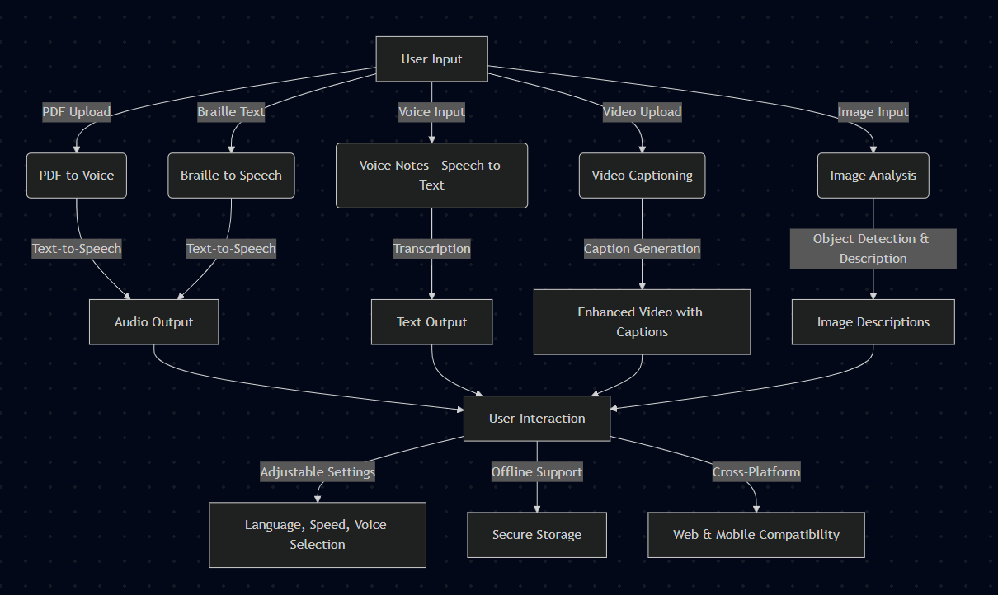
PROCESS FLOW DIAGRAM

Slide 6
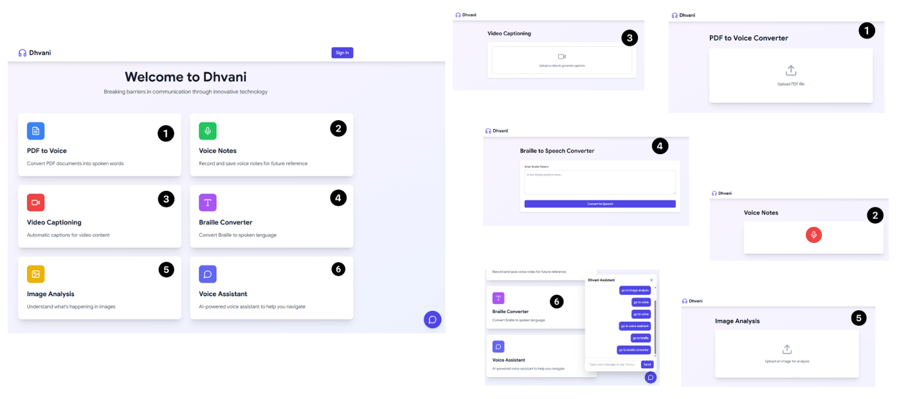
WIREFRAMES/MOCK DIAGRAMS OF THE PROPOSED SOLUTION:

Slide 7
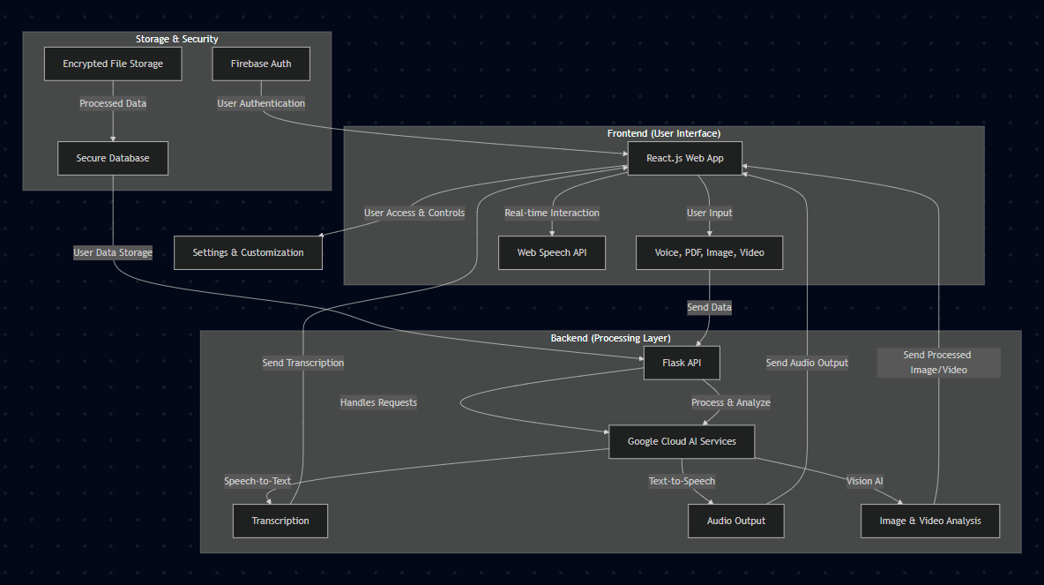
ARCHITECTURE DIAGRAM OF THE PROPOSED SOLUTION:

Slide 8
TECHNOLOGIES TO BE USED IN THE SOLUTION:
🌐 Frontend:
React 18 – For a dynamic and responsive UI
TypeScript – Ensures type safety and better maintainability
Tailwind CSS – For fast and scalable styling
Framer Motion – Adds smooth animations
Web Speech API – Enables voice interaction
📡 Deployment & DevOps:
Docker – Containerized deployment
Google Cloud Run – Serverless hosting for the backend
🛠 Storage & Authentication:
Firebase Auth – Secure user authentication
Google Cloud Storage – Secure media and file storage
Firestore – Storing user preferences & data
🔒 Security Features:
OAuth 2.0 & Firebase Authentication – Secure user access
End-to-End Encryption – Ensures privacy in data storage & transfer
Rate Limiting & API Gateway – Prevents misuse
🖥 Backend:
Flask (Python) – Lightweight backend framework
Google Cloud APIs – AI-powered features
Gemini API – Natural language processing
Speech-to-Text API – Converts voice to text
Text-to-Speech API – Converts text to natural-sounding speech
Vision AI – Image and video analysis

Slide 9
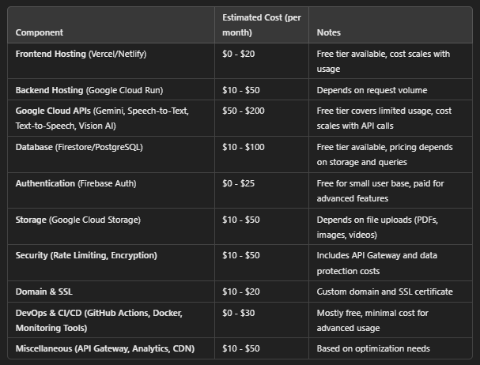
ESTIMATED IMPLEMENTATION COST:

Slide 10
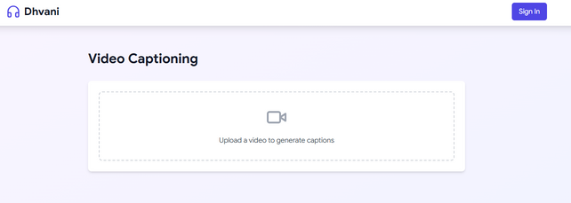
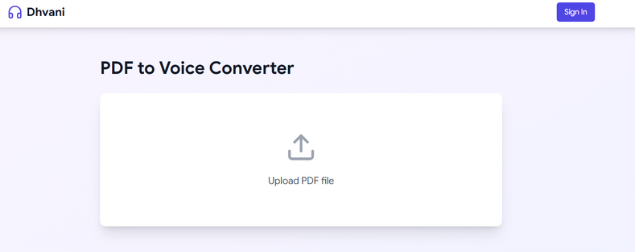

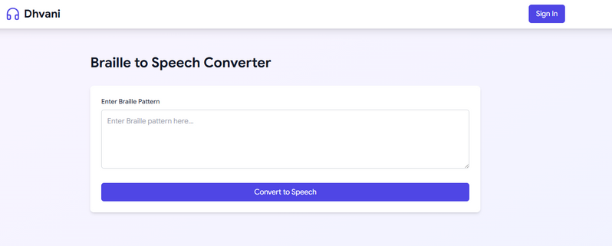
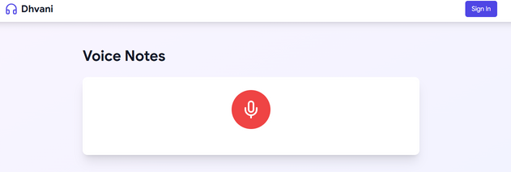
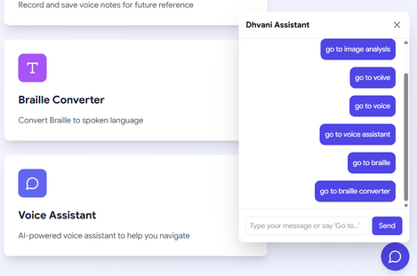
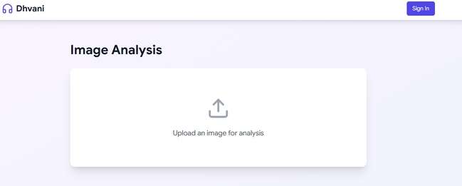
SNAPSHOTS OF THE MVP

Slide 11
GitHub Public Repository: https://github.com/rajarshidattapy/Dhvani-AI
2. Demo Video Link: https://youtu.be/dLN9QBRidUQ
3. MVP Link: dhvani-ai.vercel.app

Slide 12


